Slide 1

CubeSat – Control - Report Out
Ben Sherman
Trace Shafer

Slide 2


Software

Slide 3
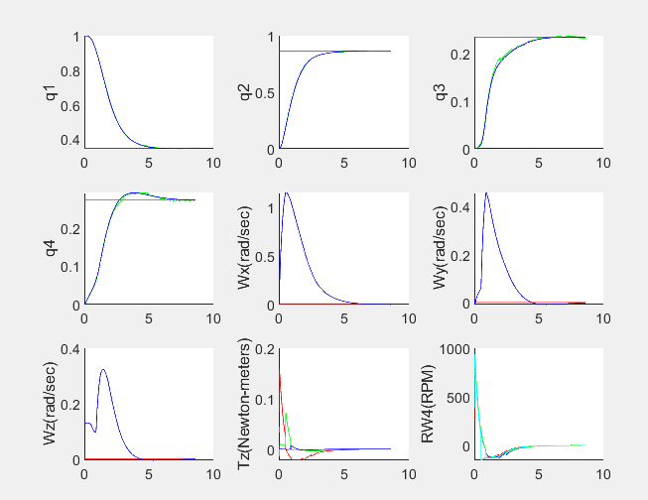
CubeSat MATLAB Simulation
Go to Drop Box -> CubeSat -> Control -> Simulation -> Simulation
Once MATLAB opens you can run it.
All files needed to run the program are within the Simulation folder.
It is a LQR controller that has gain scheduling implemented with an EKF observer

Slide 4
Rust Conversion
To convert to Rust I have been trying to make the MATLAB simulation to be in one file to be able to use AI to help convert the code into Rust.
To find that code go to Drop Box -> CubeSat -> CONTROL -> Simulation – Test -> ClaudeTest

Slide 5
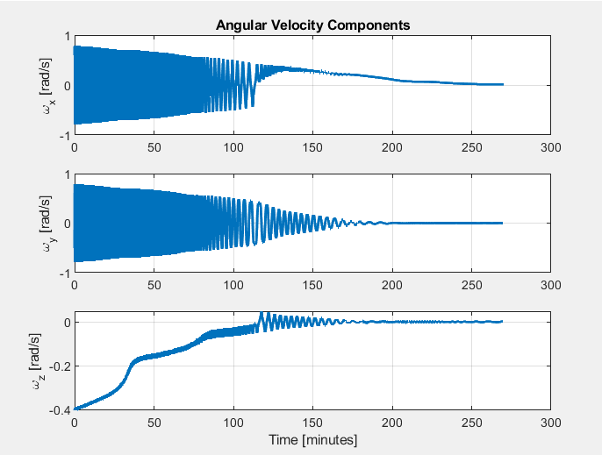
B-dot
There is a working Rust code that has B-dot running, file too large to fit in Dropbox
Cargo Run

Slide 6
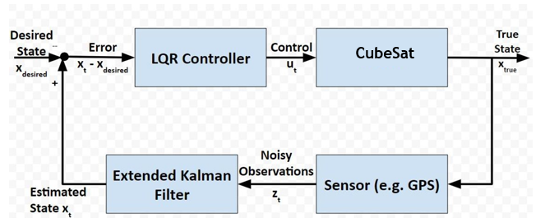
Recommended Improvements
Using Nonlinear Dynamic Inversion (NDI) Controller (Will need to figure out equations, but think it will be better suited for the CubeSat as it has nonlinearities). We implemented gain scheduling as a work around to make our control system stable.

Slide 7
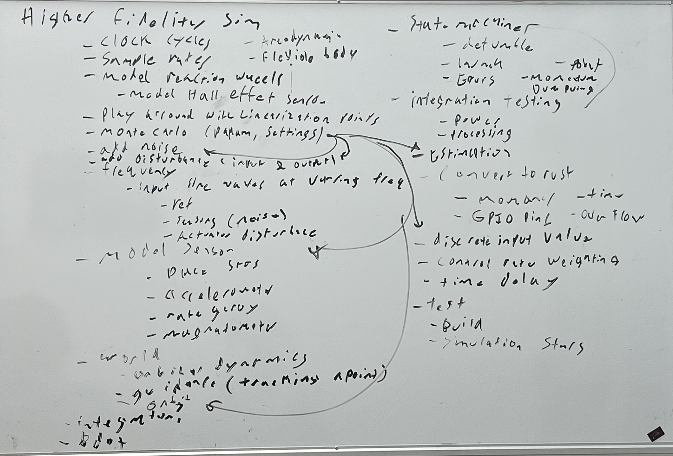
Recommended Improvements
We met with Dr. Eve's and we made a list of things that need to be done before the CubeSat goes up. Most of them are different simulations that need to be run.
To find those Drop Box -> CUBESAT -> Control -> Testing -> Dr. Eves Notes and img_evesnotes
Get those done!

Slide 8
Machining
We did machine and fully assemble the reaction wheel mount.
If the piece does need to get remade, it can be found in the manufacturing folder.
The fusion files are in there that are needed for the CNC, and pictures are included for what needs to be done on the manual mill. The tool library can also be found, please meet with Professor Schiller if tool numbers have changed in the DMG Mori.
The stl files for the jig I used for drilling the holes can be found in the manufacturing folder as well.

Slide 9
Testing
We could not test this year due to parts not arriving on time and the MATLAB simulation not being converted into rust.
We have a list of testing requirements on our test readiness review that need to be tested, that can be found in the reviews folder.

Slide 10
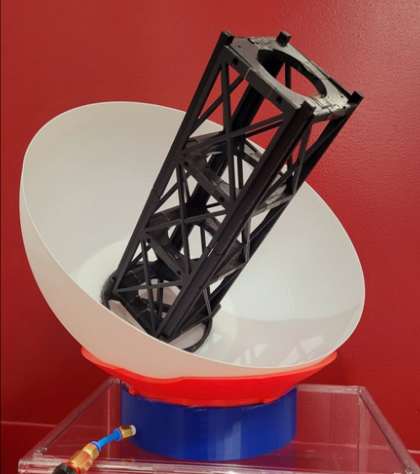
Testing
We do have a test fixture (spherical air bearing), and the paper that we referenced for the air bearing found in the test folder, as well as the 1U stl files that I scaled up to 3U. The 3U files can also be found the testing folder.
Hook it up to the compressed air
3D printed an attachment to add a laser pointer to confirm accuracy

Slide 11
Suggested Next Steps
Implement Magnetometer sensor to the Observer file.
Implement Sun Sensor (photodiodes on Solar Panel Board) as back up to Star Tracker.
Get a working control board and hook a motor up to it, use Rust to spin a motor.

Slide 12
Contact Info
Traceshafer@gmail.com (385) 347-8235
Benjaminsherman18@gmail.com (385) 233-8013
All the equipment can be found top right of cabinet 27.
The reaction wheel mount and the motors are on the CubeSat.

